Slide 1

A time series approach for option pricing
Capstone project
Quinn Le

Slide 2
Goal Statement
The goal is to see if the time series approach yields a better result than Black-Scholes formula.
The option price is stochastic which is determined by supply and demand. Therefore, the price can be different from the price from Black-Scholes model (which is a well-known model in Finance which is used to price option). We would like to answer the question whether the time series models give a better prediction than the Black-Scholes model.

Slide 3
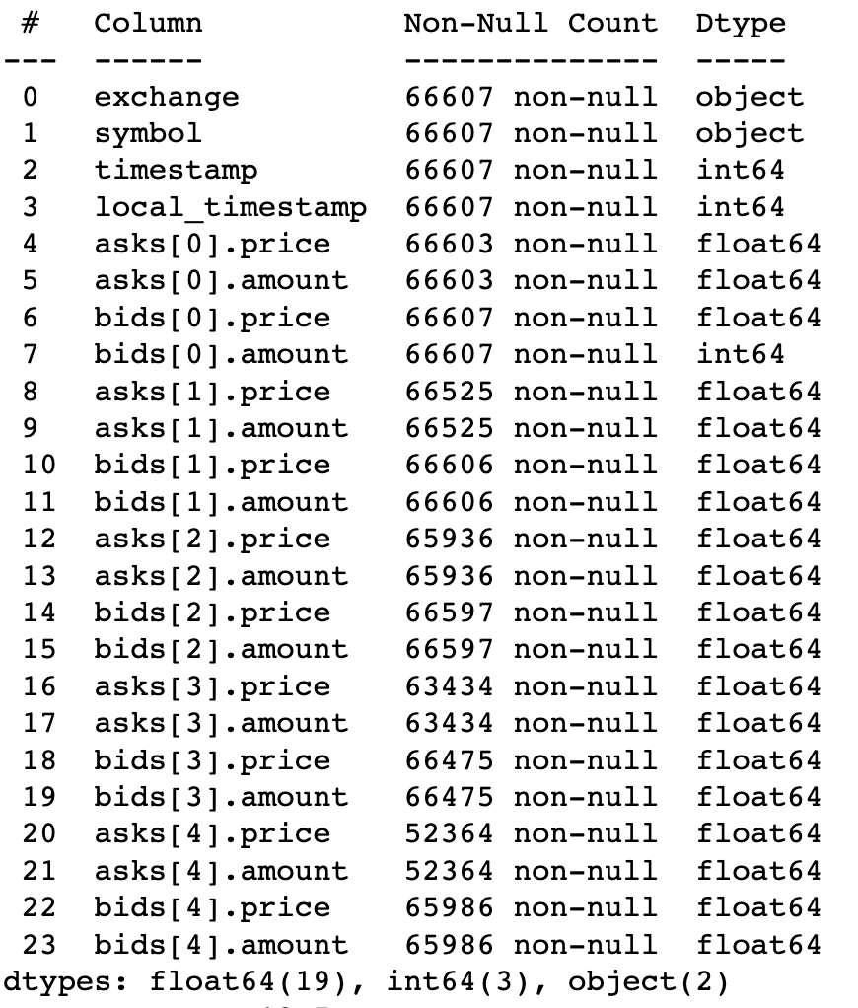
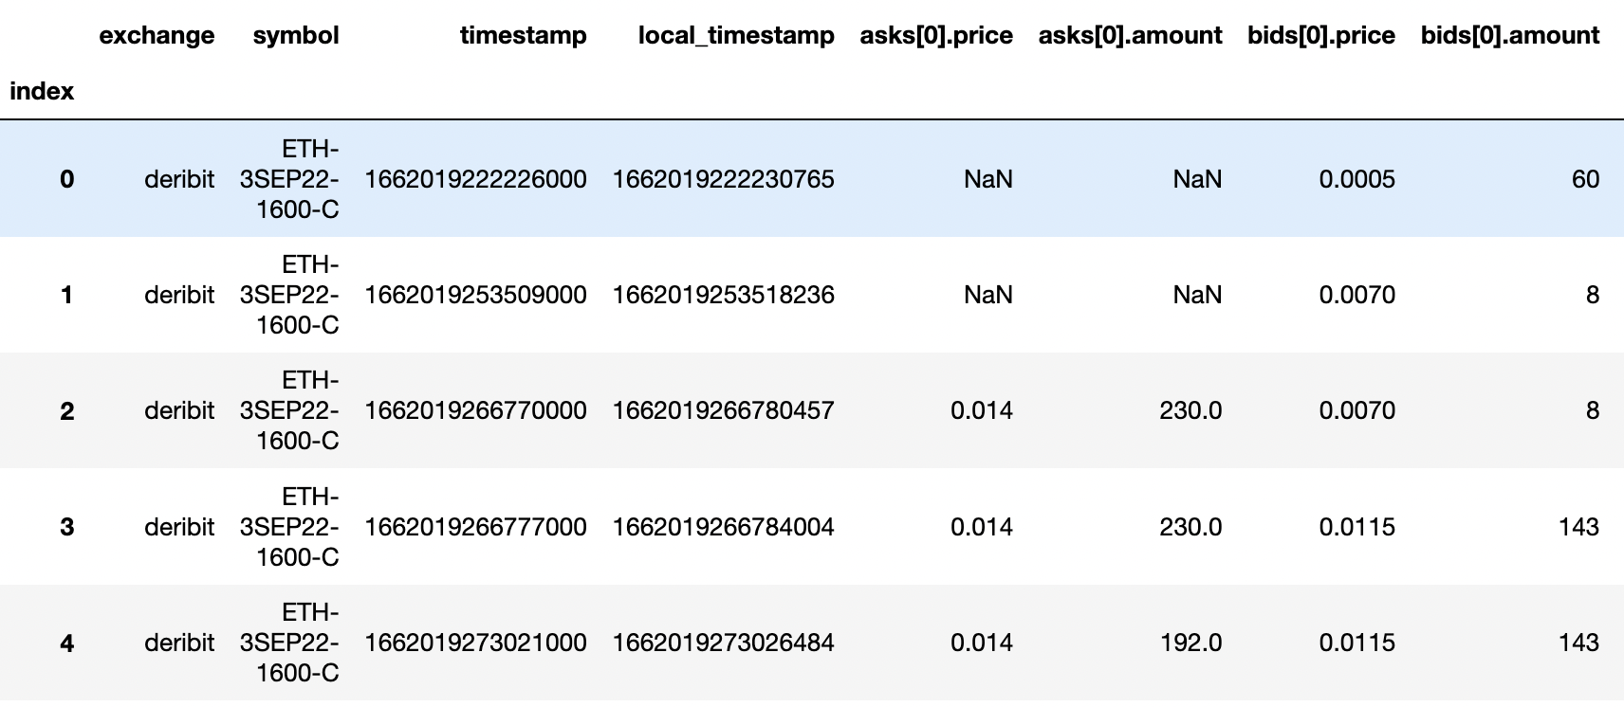
Data overview
Ethereum option data from Sep 2022 to Oct 2022
The option type is European Call option

Slide 4
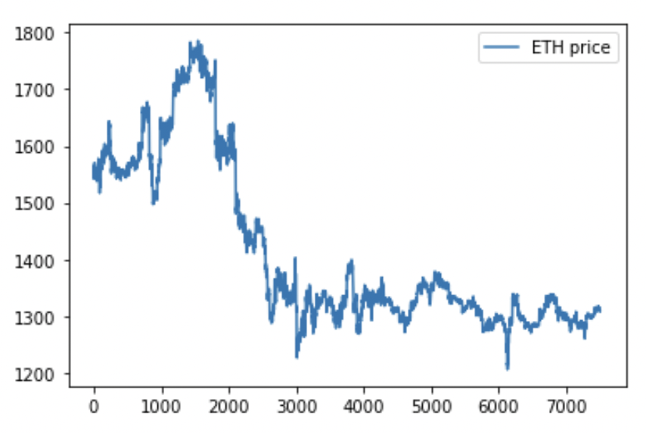
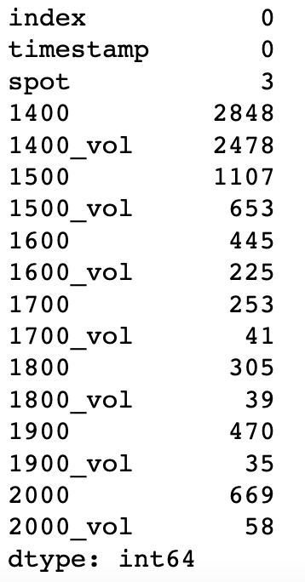
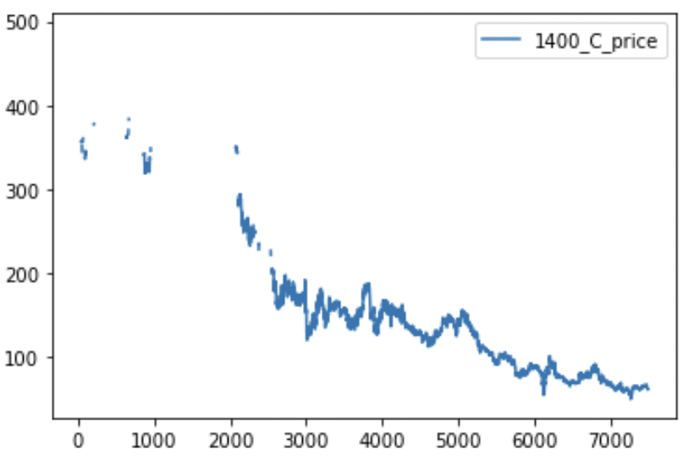
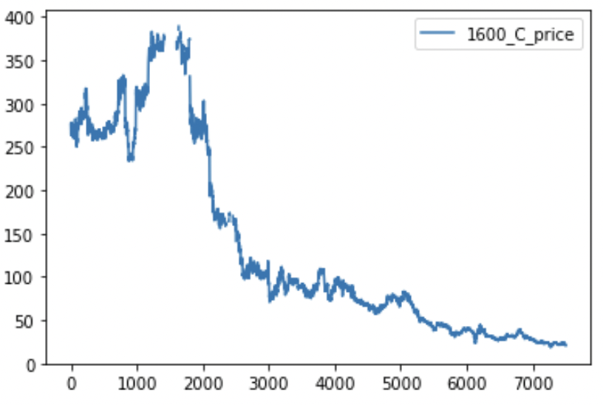
Missing value summary

Slide 5
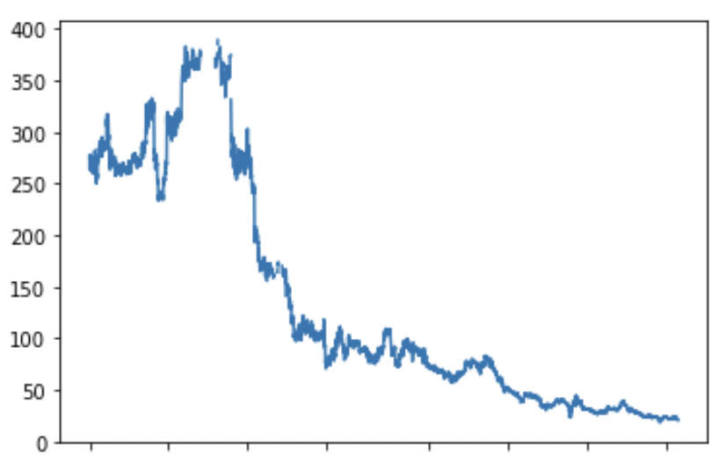
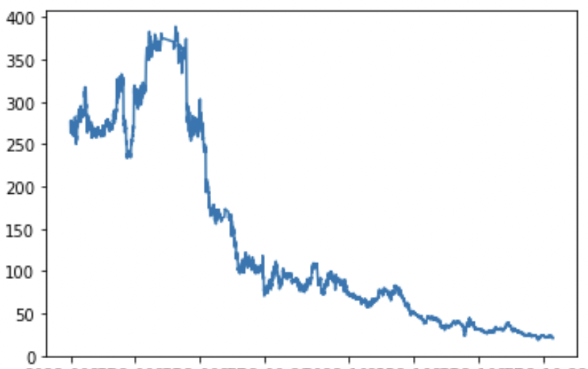
Data Wrangling
Remove data points without bids[0].price or asks[0].price
Remove data points with big bid-ask spread ( > 0.005)
Remove data points with low transaction volume ( < 10 ETH)
Fill NaN by linear interpolation

Slide 6
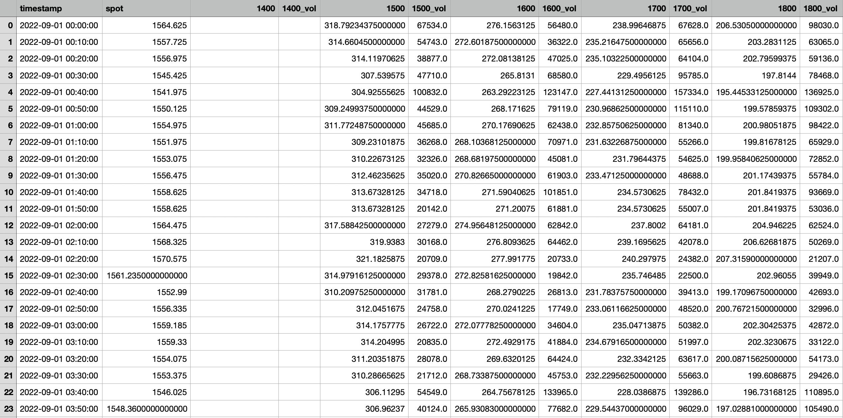

Slide 7
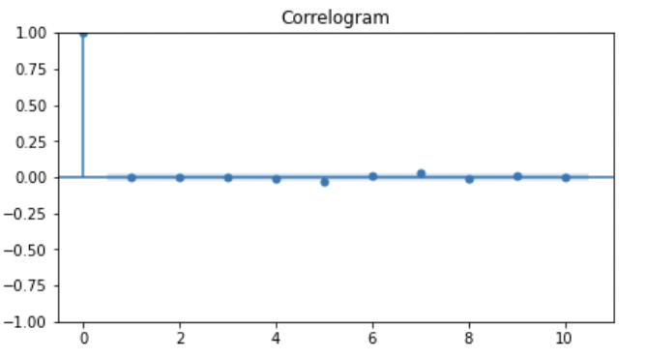
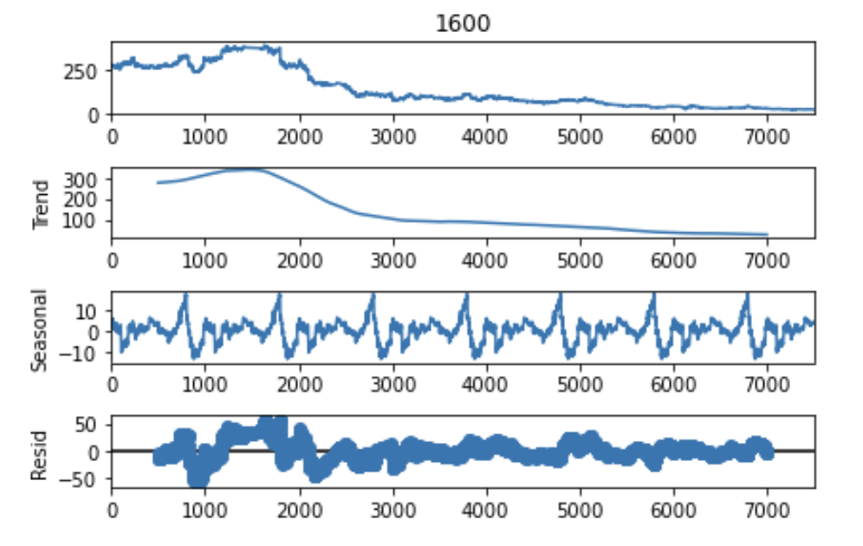
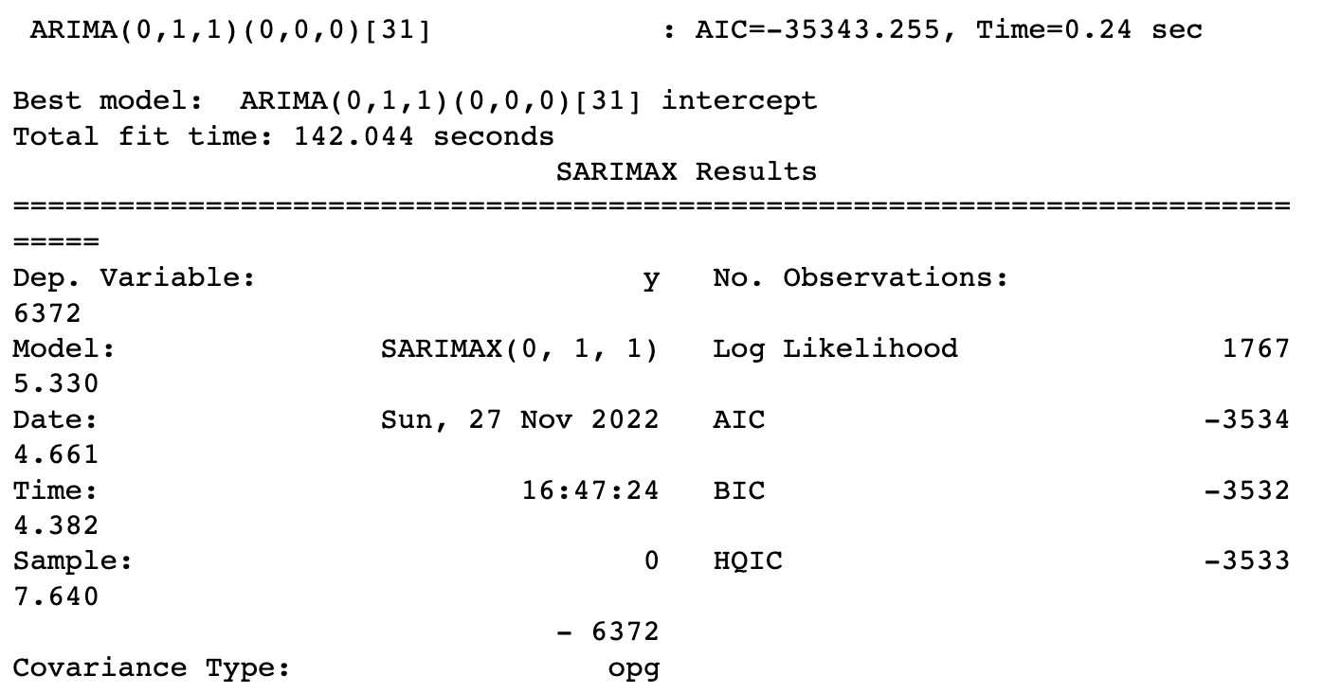
ARIMA MODEL
The best model is ARIMA(0,1,1)

Slide 8
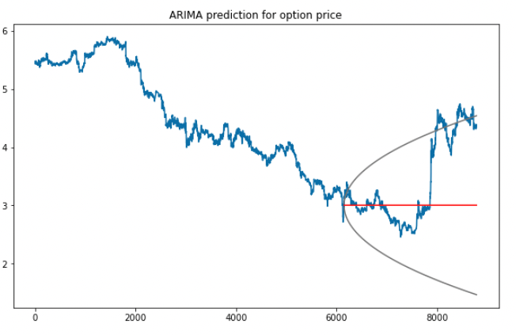
ARIMA RESULT
Mean squared error: 0.679
Mean absolute error: 0.581

Slide 9
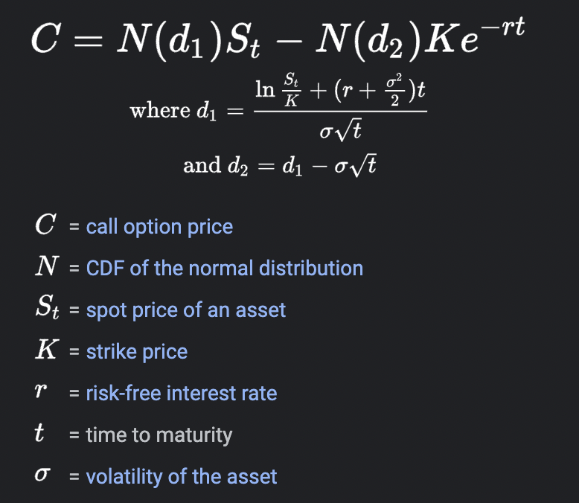
Black-scholes formula
In our problem:
Spot price = 1267.475
Maturity time = Nov 25th 2022
Strike price = 1700
Volatility: 6-week average vol & 1-week average vol

Slide 10
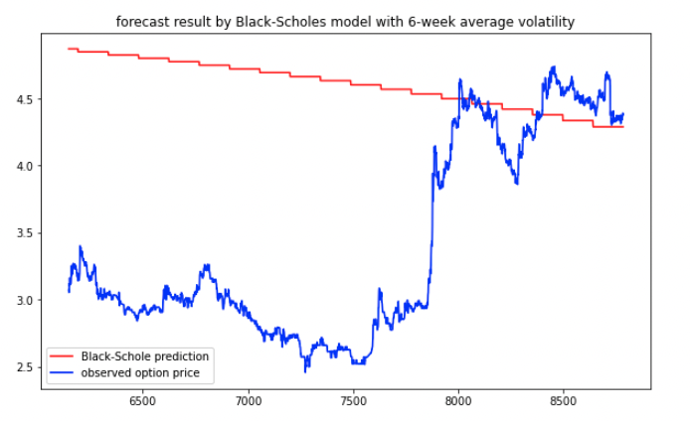
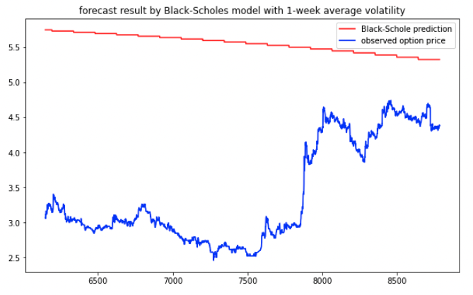
Black-scholes results
MSE: 2.214 MAE: 1.269
MSE: 5.343 MAE: 2.159

Slide 11
Summary AND PROPOSED IMPROVEMENTS
ARIMA: 0.679
BS with 6-week volatility: 2.214
BS with 1-week volatility: 5.343
Overall, ARIMA performs better in terms of MSE and MAE. Moreover, it gives a 95% confidence interval with covers most of the observed data.
The Black Scholes models with 6-week volatility performs better than the 1-week one in term of MSE. However, the price predicted by the later might be useful in some cases, for example, option seller.

Slide 12
PROPOSED IMPROVEMENTS
For now, we simply use the average volatility for our model. Therefore, better volatility modeling will improve the accuracy for Black-Scholes model (GARCH for example).
Neural network approach: Recurrent neural network (RNN) or Long short term memory LSTM etc.

Slide 13
THANK You for your attention!

